Slide 1

CCTV Image Captioning using Deep Learning
Revolutionizing CCTV Monitoring with Deep Learning
Presenter : Amal KM

Slide 2
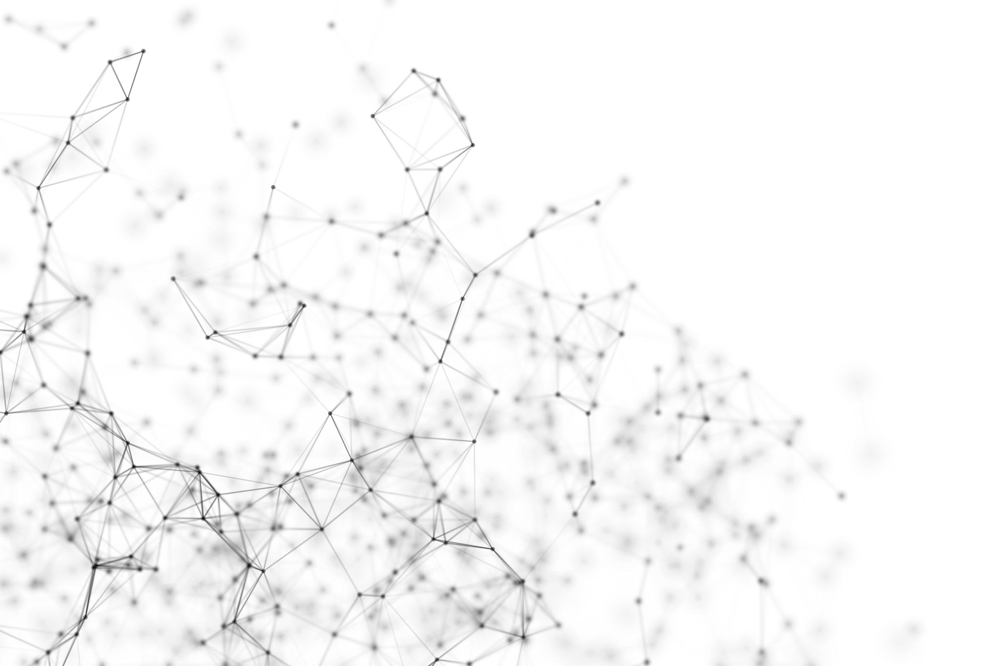
Image Captioning using Deep Learning
Definition
This is based on two sub-tasks; Computer Vision and Natural Language Processing to create textual descriptions associated with images.
Process
Involves extraction of features from images using Convolutional Neural Networks(CNNs) and caption generation with Recurrent Neural Networks (RNNs).
Output
It includes meaningful and comprehensive textual descriptions of the image content.

Slide 3
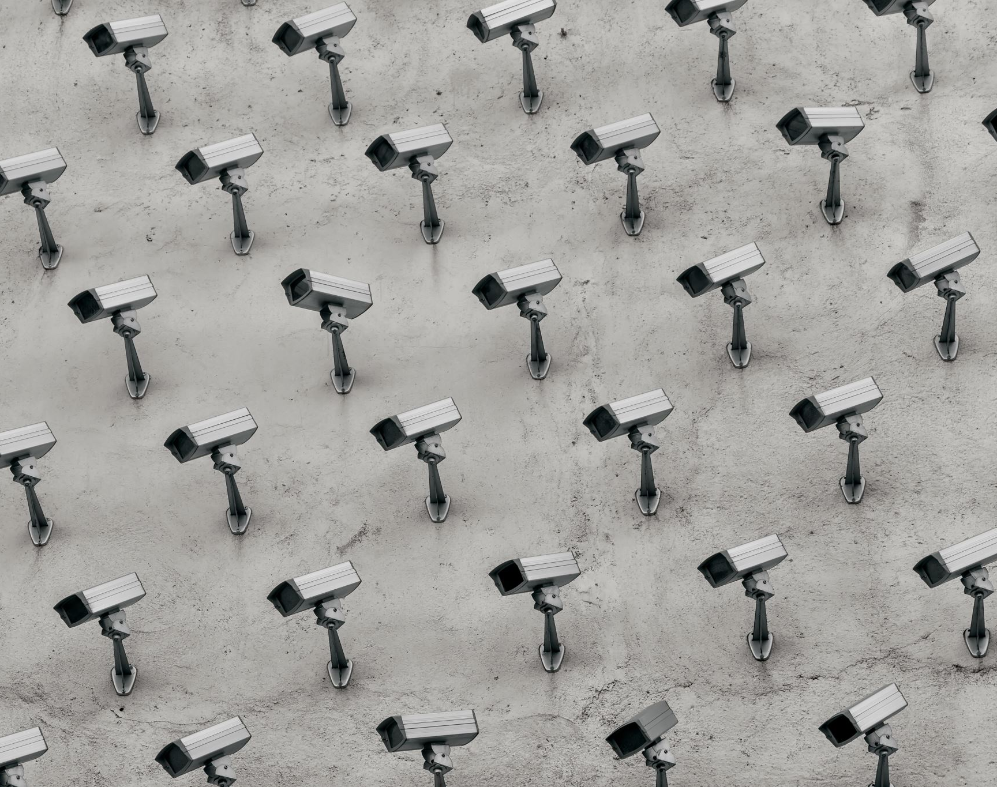
Problem Statement
CCTV cameras create a massive amount of CCTV cameras create a massive amount of visual data, which is difficult and labor-intensive to observe manually for people 24/7.
Automated analysis and description of the content in surveillance images are essential to make these CCTV cameras more efficient and effective.
This project aims to develop a deep learning model that automatically generate descriptive captions (descriptions) of images from CCTV cameras.

Slide 4
Applications of image captioning
Enhancing Surveillance Through Advanced Technology
Industry | Application | Example
Wildlife Conservation | Animal behavior monitoring | Tracking endangered species movements
Tourism | Crowd management | Identifying overcrowding at popular attractions
Military | Threat detection | Recognizing suspicious activities in sensitive areas
Healthcare | Patient monitoring | Detecting falls or distress in elderly care facilities
Retait | Shoplifting prevention | Identifying potential theft incidents
Transportation | Traific management | Detecting accidents or road obstructions

Slide 5
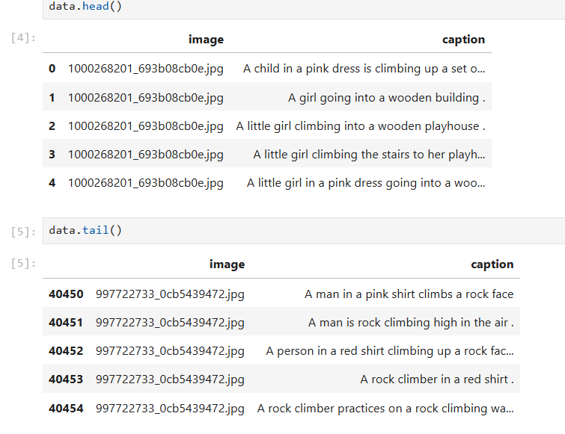
Dataset Used
Dataset:
Used Flickr8K dataset to build an automated image captioning system. This dataset contains upto 5 captions for each images.
Components
The total number of images present in this dataset is 8091 and also their respective captions. The total file size of this dataset is 1.05 GB.

Slide 6
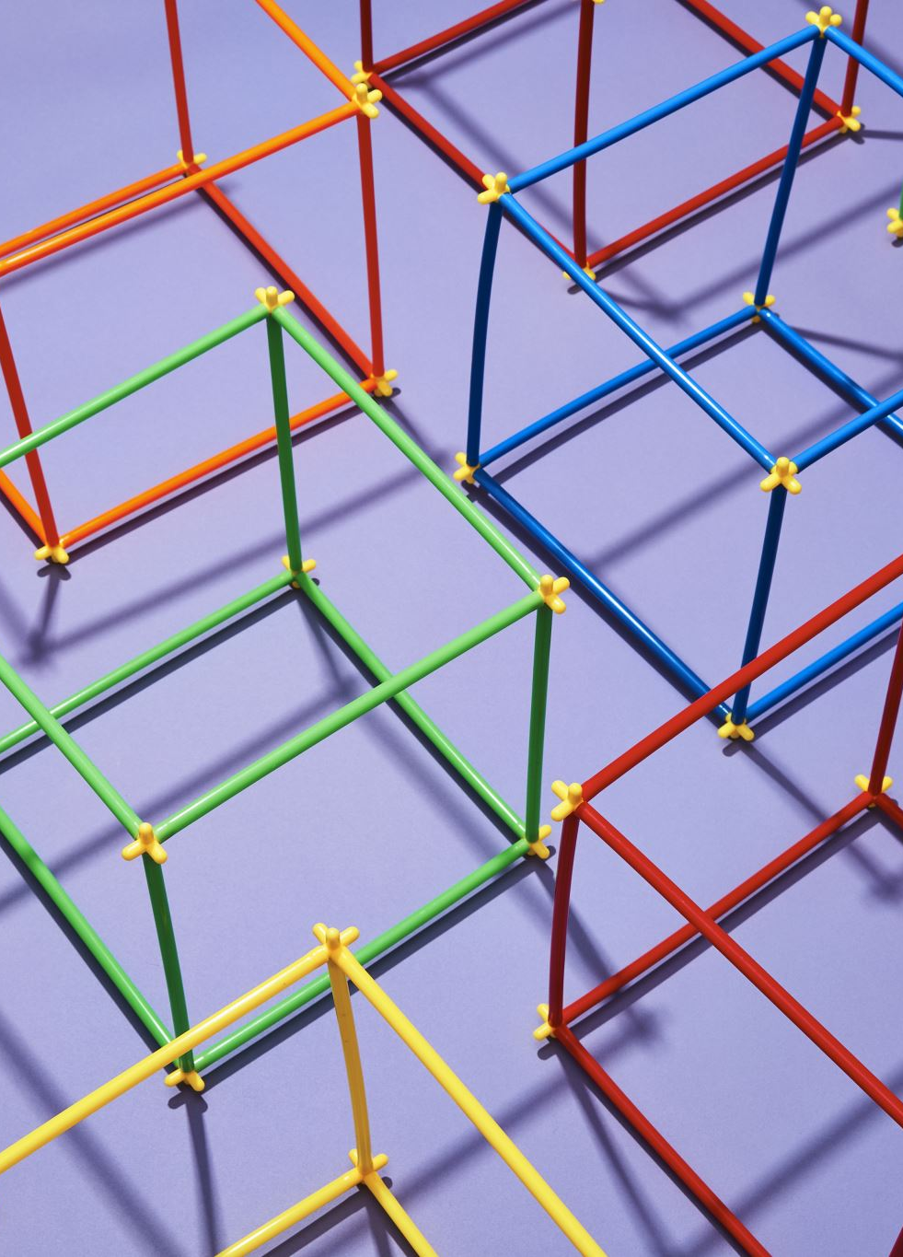
Methodology
Data collection
Data exploration and Data Preprocessing
Model Building
Training or Fitting
Evaluation and Deployment
Parameter tuning and performance metrics

Slide 7

Preprocessing of Dataset
Text Preprocessing
Involves cleaning and preparing the captions or descriptions for building the model.
Techniques used include converting to lower case, removing stopwords, removing numbers, removing punctuations and special characters, removing tags and URLs and so on.
Stemming and Lemmatization can also be used as a part of text preprocessing.
Image Preprocessing
Involves cleaning, resizing and normalizing images before used as an input.
This helps the model to understand and study the images better.
Also used a pre-trained DenseNet201 model for extracting the features from the images.

Slide 8
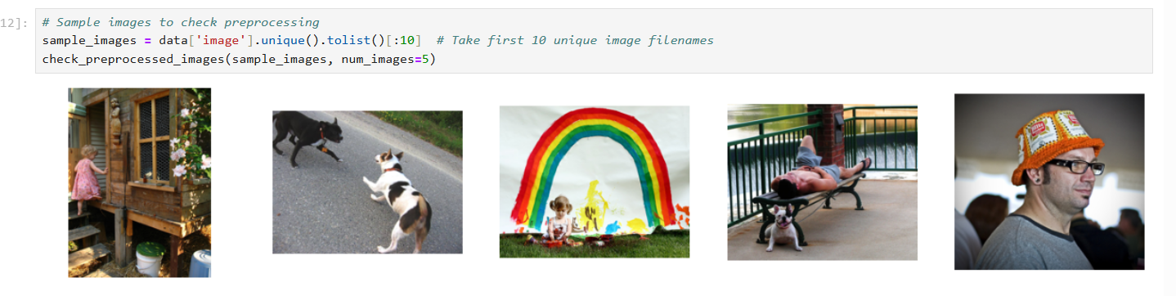
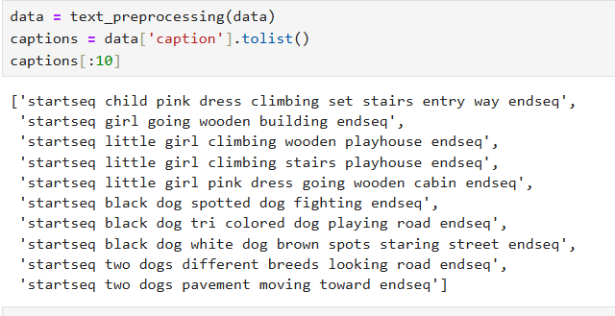
Preprocessing

Slide 9

Modelling Approach
Feature extraction
Text preprocessing
Splitting the dataset(training(70%), testing(20%) and validation (10%))
Data generator to create batches of images features and their corresponding captions
Defining the architecture of the model.
Training the model
Evaluation and prediction
Performance metrics

Slide 10

Full Code review on Jupyter Notebook

Slide 11
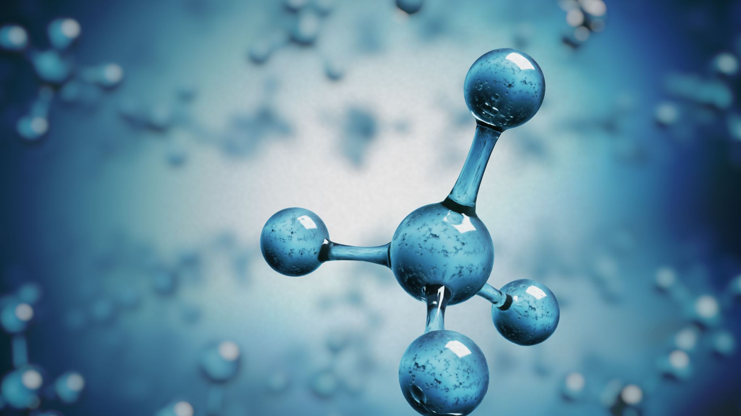
Model Architecture
Created a model involving a combination of both CNN for image feature extraction and RNN(specifically LSTM) for sequence generation.
It has 3 parts: encoder, sequence model and decoder
Also, compiled the model and use optimizer ‘adam’.
Created 2 models and fine-tuned 2nd model for better performance.

Slide 12
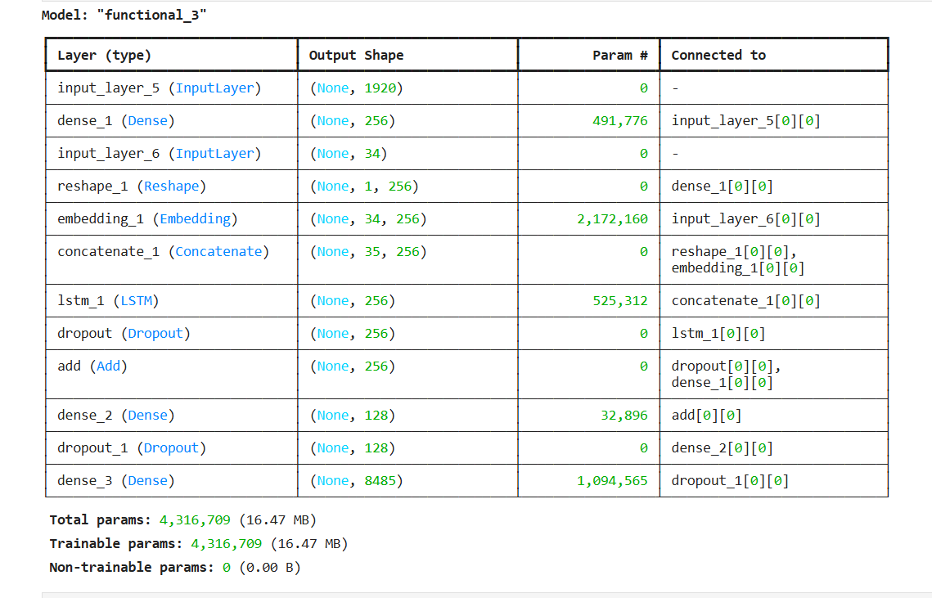
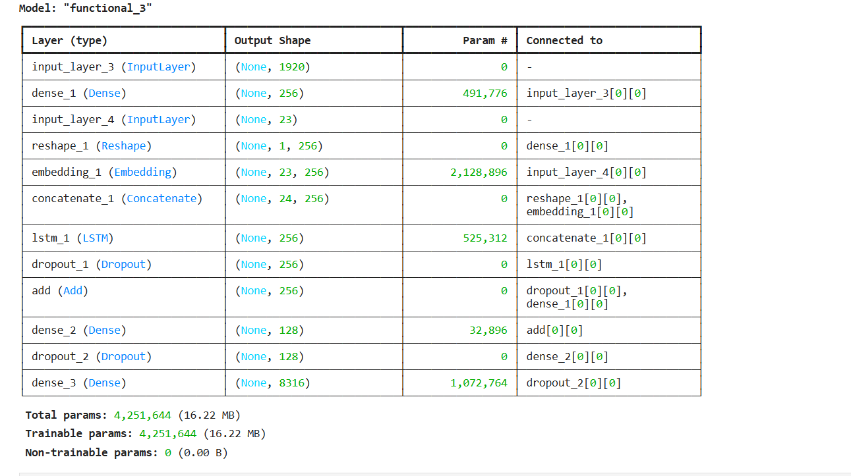
Models
Model-1
Model-2

Slide 13
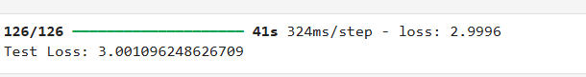
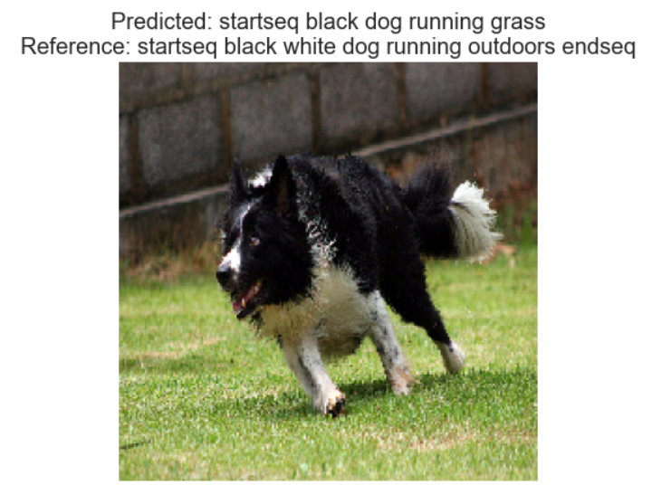
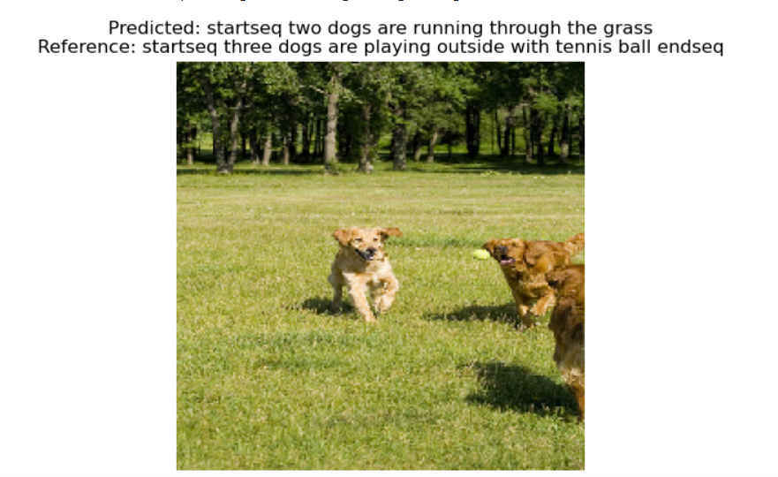
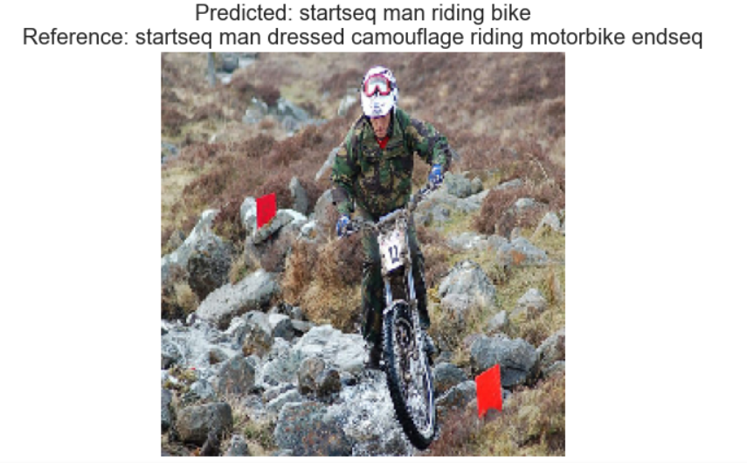
Model Results
Model-1
Model-2

Slide 14
Recommendations
Even though the models were able to predict and generate captions according to the images, the results were not that sound.
Based on the bleu score and test loss, this may not be the best performing model but this project helps to understand how image captioning problems can be approached.
Use of more powerful pretrained CNN model for feature extraction can help to increase efficiency.
Incorporating a feedback loop can help to improve performance iteratively.
Fine tuning models using transfer learning techniques can also help in this case.

Slide 15
Thank you

